Slide 1

ENCRYPT - O - DECRYPT
PRESENTATION BY : MENTOR : GUIDE :
K Sheshadri PAI (4NM19CS088) SAHIL B MS. ANKITHA A NAYAK

Slide 2
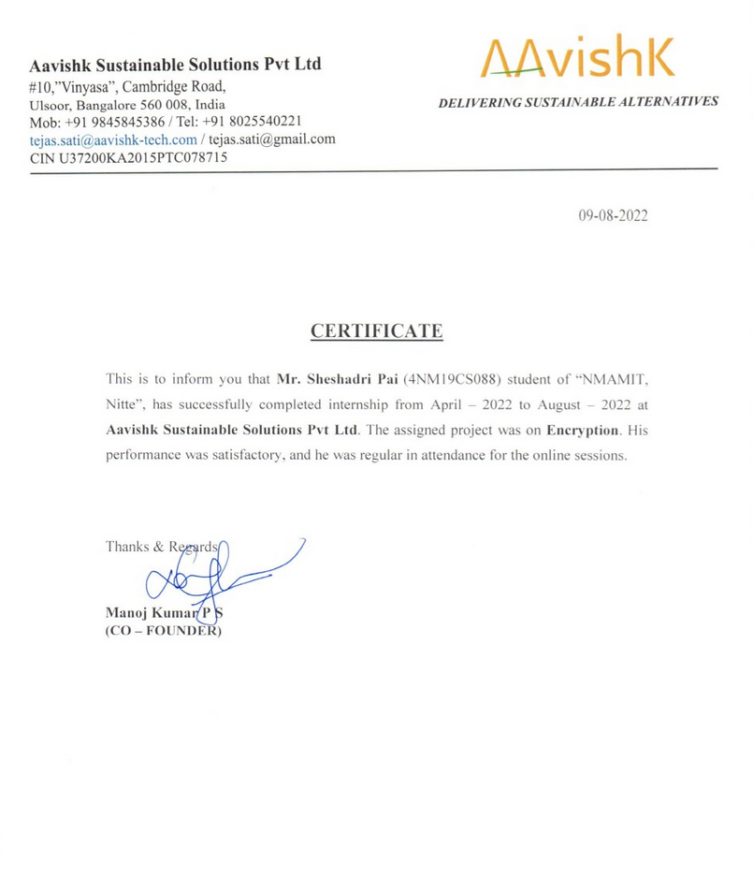

B2B channel commerce and engagement platform.
Headquartered in Bangalore.
Offers partners tools to sell online, manage remote businesses.
Helps brands manage their network of channel commerce and make data-driven decisions with valuable insights.

Slide 3
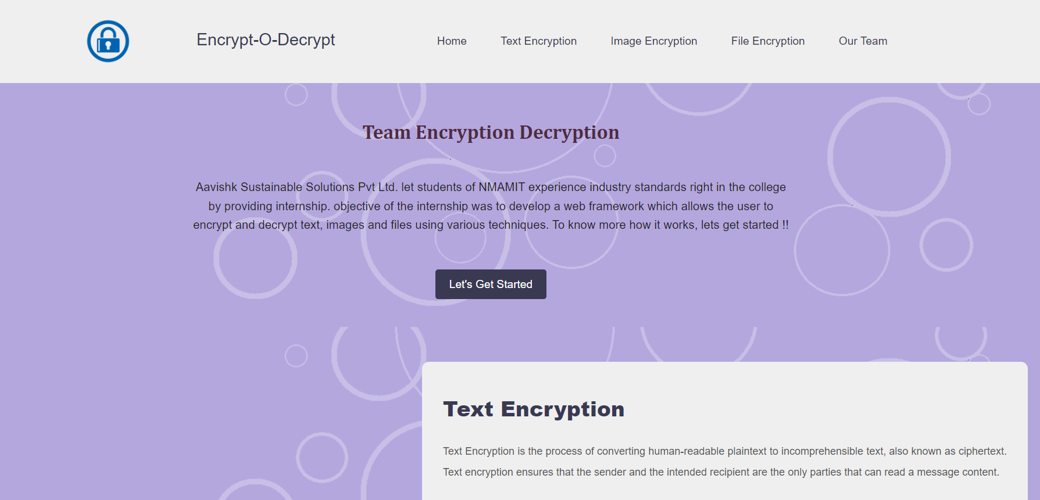
Fig. 1 Landing Page

Slide 4
Text Encryption
The process of converting human-readable plaintext to incomprehensible text, also known as ciphertext.
Text encryption ensures that the sender and the intended recipient are the only parties that can read a message’s content.
RSA, AES and TDES are the algorithms we have used in our project.
Plain text is encrypted using an encryption algorithm and an encryption key.
Here the information is converted into secret code that hides the information’s true meaning.

Slide 5
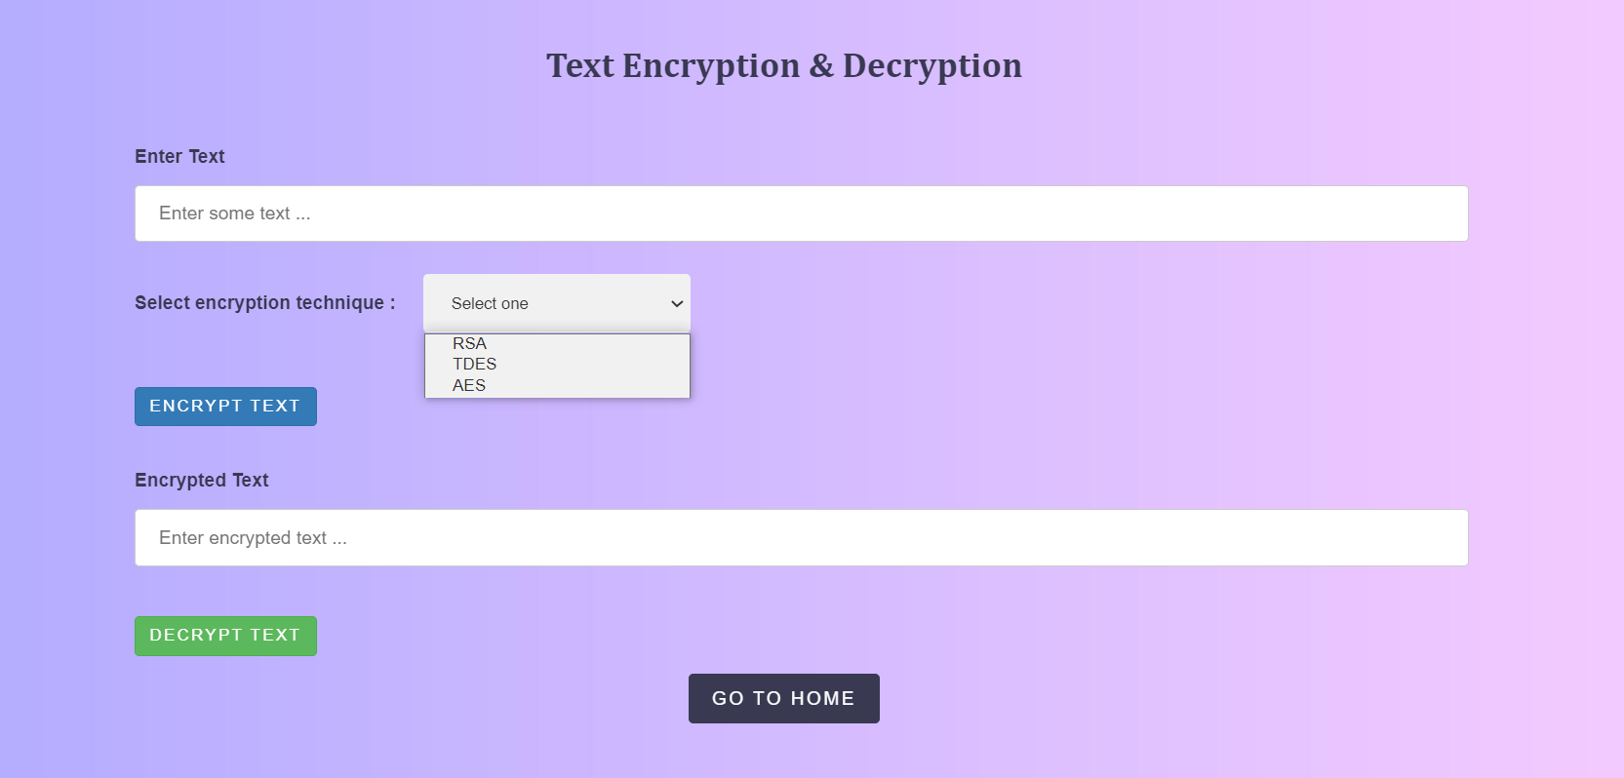
Fig. 2 Text Encryption Page

Slide 6
Image Encryption
The process of encoding secret image with the help of some encryption algorithm in such a way that unauthorized users can’t access it.
Image encryption has applications in internet communication, multimedia systems, medical imaging, telemedicine, military communication etc.
Triple DES (TDES) is the algorithm that is being implemented in our project.
We encode the Image to Base64 code using TDES and then the Base64 code is later decoded and original image is obtained.

Slide 7
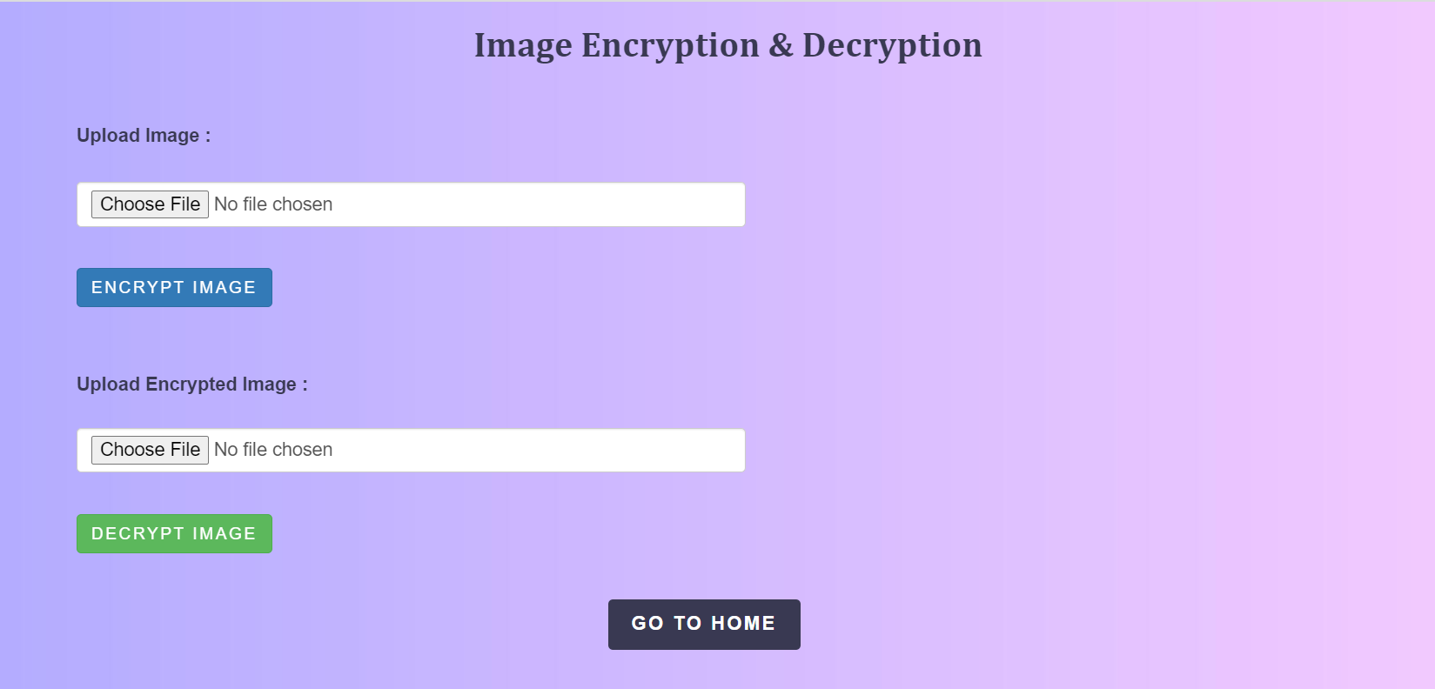
Fig. 3 Image Encryption Page

Slide 8
File Encryption
The process of encoding files, including the sensitive data they contain, in order to send them securely.
File encryption sees to it that our files are not at risk, also ensuring that the security is not compromised.
RSA is the algorithm that is being implemented for file encryption.
Here we encode the file in .pdf format to Base64 code using RSA and then the Base64 code is later decoded and the original file is obtained.

Slide 9
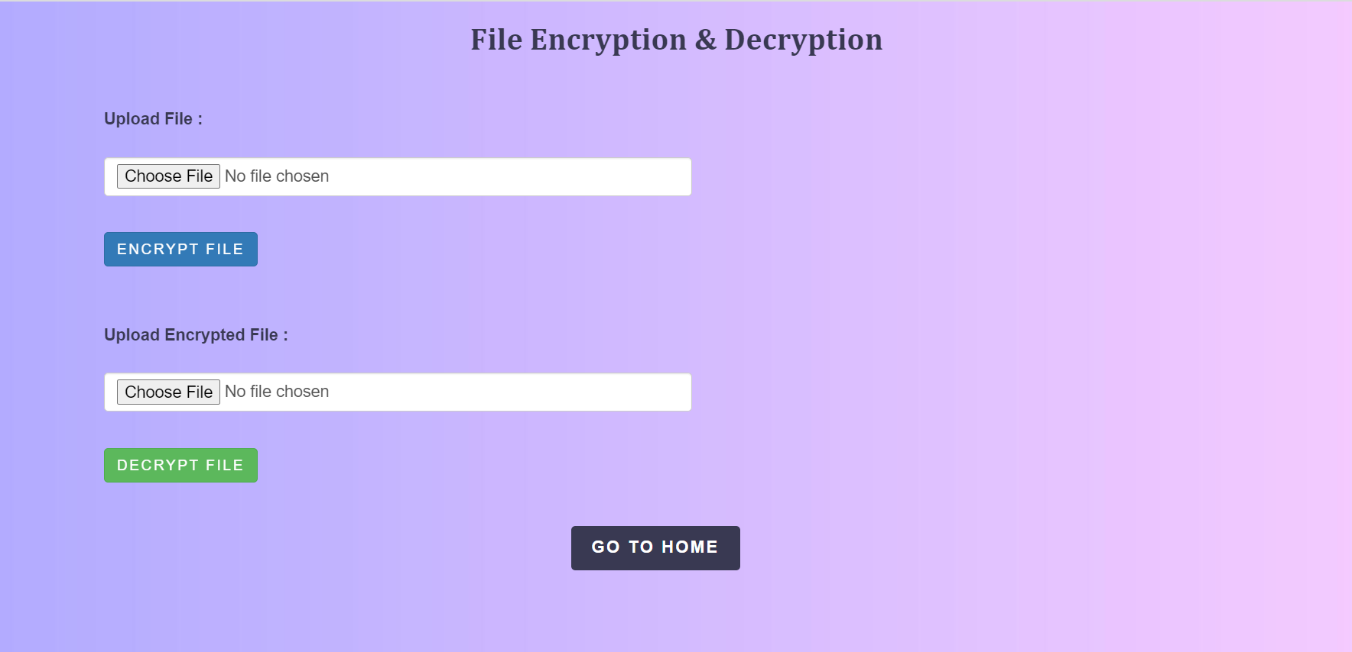
Fig. 4 File Encryption Page

Slide 10
Technology And Algorithms
The technologies used here are : Node js and Express.
We have used different encryption techniques like AES, TDES, RSA.
In order to convert image to encrypted data we used image-to-base64.
And to convert pdf to encrypted data we used pdf-to-base64.
We used npm install packages as follows.
RSA technique: npm install node-rsa
TDES technique: npm install node_triple_des
AES technique: aes-256-cbc

Slide 11
Technology And Algorithms
We also used multer and security key.
Multer is a node. js middleware for handling multipart/form-data , which is primarily used for uploading files.
One can enable two-factor authentication (2FA) on npm user account to protect against unauthorized access to account and packages, by using a security-key.
We also used fs module and path module which provides a lot of very useful functionality to access and interact with the file system.

Slide 12

Our Experience As A Team
It was a great experience being a part of Avysh.
All in all, got to learn a lot from this internship.
Amount of knowledge that we got is truly a blessing.
Got basic knowledge on how corporate world works.
Friendly atmosphere where each of us helped one another.
Time management skill is the key highlight of this internship.
It also introduced to work in groups and brainstorm our mind.

Slide 13
Benefits of encryption for Avysh
Securing sensitive user data which will be used for KYC in the future.
Using various techniques to enhance the security layer of API.
Protecting data at every stage of its journey against data loss or theft when the data transfer occurs.
To comply regulations set by the government or by the organization.
Gain trust of customers by letting them know that all their sensitive data is secured.

Slide 14
THANK YOU

